Slide 1
Data engineering
Case Study on Covid-19 Data Warehouse
Manav Patadia
manavnp_mca2107423@ahead.students.amrita.edu
Roll Number: AA.SC.P2MCA2107423

Slide 2
Objective
Extract data from various websites about covid-19.
Process, clean and transform extracted data and form data marts and data warehouse.
Analyze its impact on health, economics and environmental aspects of human lives across India. I have stock data to measure impact of covid19 on Indian economics. I have pollution data to measure impact of covid19 on environment. I have death data to measure impact of covid19 on Indian health.
Visualize analyzed data in python

Slide 3
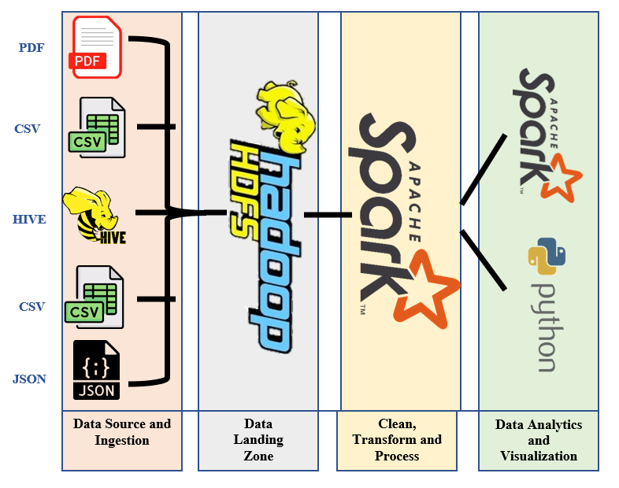
PROCESS Diagram

Slide 4
Stakeholders of this project:
Government, Financial advisors, Stock analysts, Students
Tools Used:
Py-Spark (Data Processing), Hive (Data Storage), HDFS (Data Storage) and Python (Visualization)
Region Selected for this Case study:
India

Slide 5
Dataset details
Dataset 1: Daily Covid 19 Case Details
Columns: Date, State, Confirmed_Indian_Cases, Confirmed_Foreign_cases, Cured, Deaths
Source: https://raw.githubusercontent.com/datameet/covid19/master/data/mohfw.json
Format: JSON
Record Count: 34991

Slide 6
Dataset details
Dataset 2: State_codes
Columns: Subdivision category, 3166-2 code, Subdivision name
Source https://en.wikipedia.org/wiki/ISO_3166-2:IN
Format: CSV
Record Count: 37

Slide 7
Dataset details
Dataset 3: Daily Covid Vaccination details
Columns: Date, State, dose_1, dose_2, 15_18_years_dose_1, 15_18_years_dose_2, 12_14_years_dose_1, 12_14_years_dose_2, precaution_dose, total_doses
Source: https://thejeshgn.com/2020/03/16/novel-corona-virus-covid19-archive-api-india-data/
Format: PDF
Record Count: 589 PDF files and Total Rows: 22447

Slide 8
Dataset details
Dataset 4: Pollution Data
Source: https://api.data.gov.in/resource/3b01bcb8-0b14-4abf-b6f2-c1bfd384ba69
Big Query Public Table: bigquery-public-data.openaq.global_air_quality
Columns: location, city, country, pollutant, value, timestamp, unit, source_name, latitude, longitude, averaged_over_in_hours, location_geom
Format: Big Query Google Table
Record Count: 5594614

Slide 9
Dataset details
Dataset 5: List_of_cities_and_towns_in_india
Columns: Subdivision category, 3166-2 code, Subdivision name
Source:https://www.downloadexcelfiles.com/sites/default/files/docs/list_of_cities_and_towns_in_india-834j.csv
Format: CSV
Record Count: 1318

Slide 10
Dataset details
Dataset 6: Daily Nifty-50 Details
Columns: Date, Open, High, Low, Close
Source: https://www.niftyindices.com/reports/historical-data
Format: Hive Table
Record Count: 927

Slide 11
Plan to Execute
Step 1: Load data from 6 different sources into spark DataFrames
Step 2: Prepare data pipeline for the datasets using Spark
Step 3: Clean all the dataset thoroughly using Spark
Step 4: Transform and process the data to make it ready for analysis using Spark
Step 5: Analyze the datasets to draw conclusions from them using Spark
Step 6: Explain conclusions using visualizations using Python

Slide 12
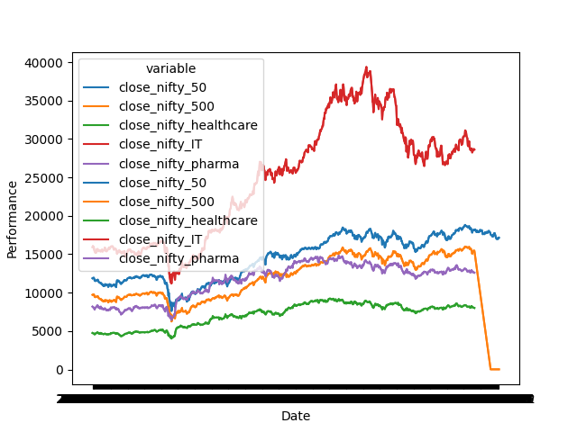
Data Visualization

Slide 13
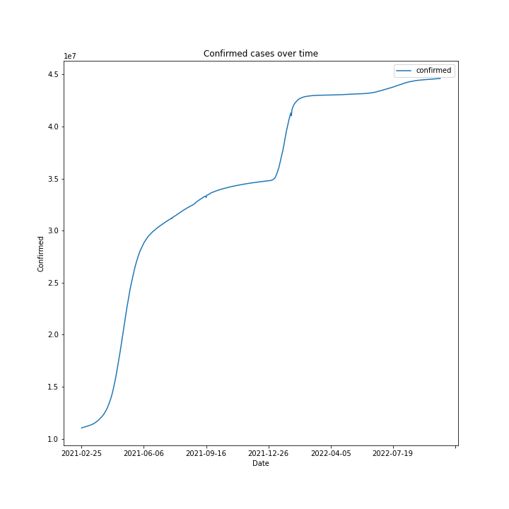
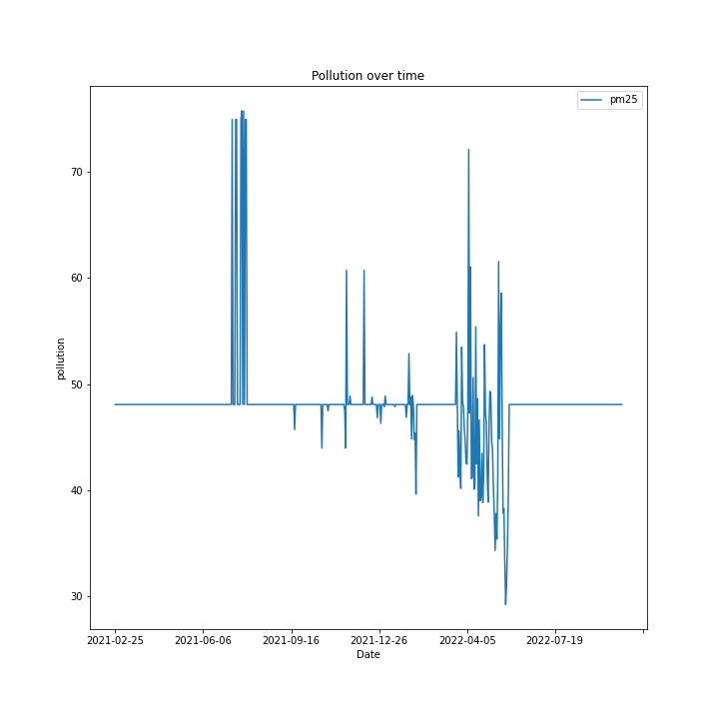
Data Visualization

Slide 14
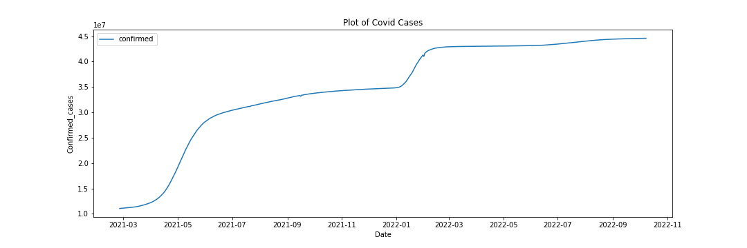
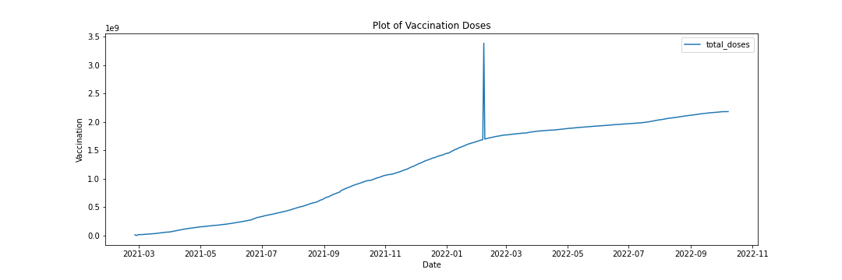
Data Visualization

Slide 15
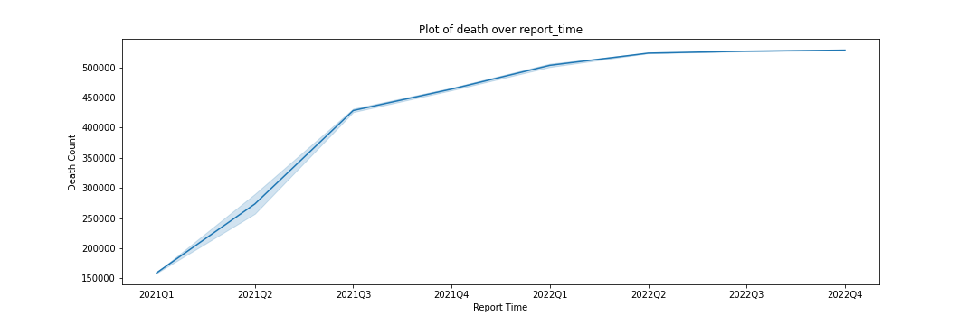
Data Visualization

Slide 16
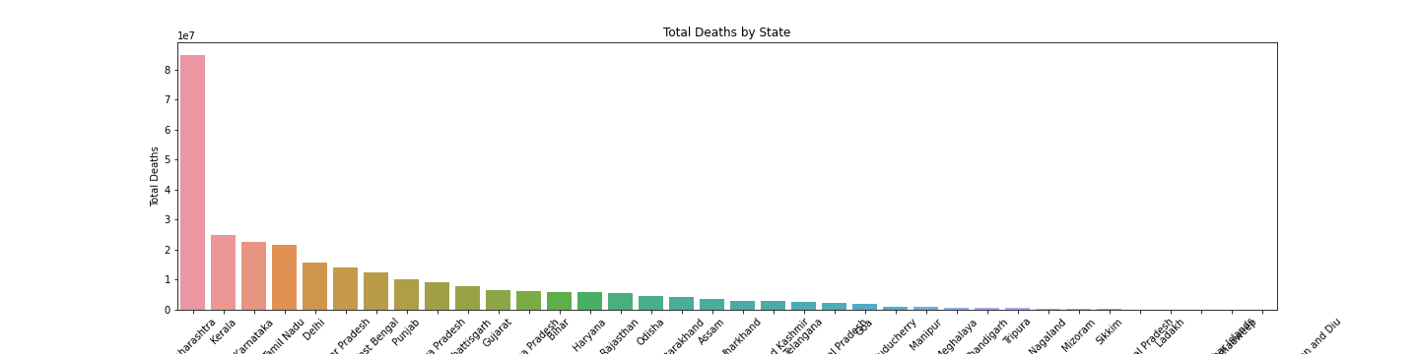
Data Visualization

